Slide 1
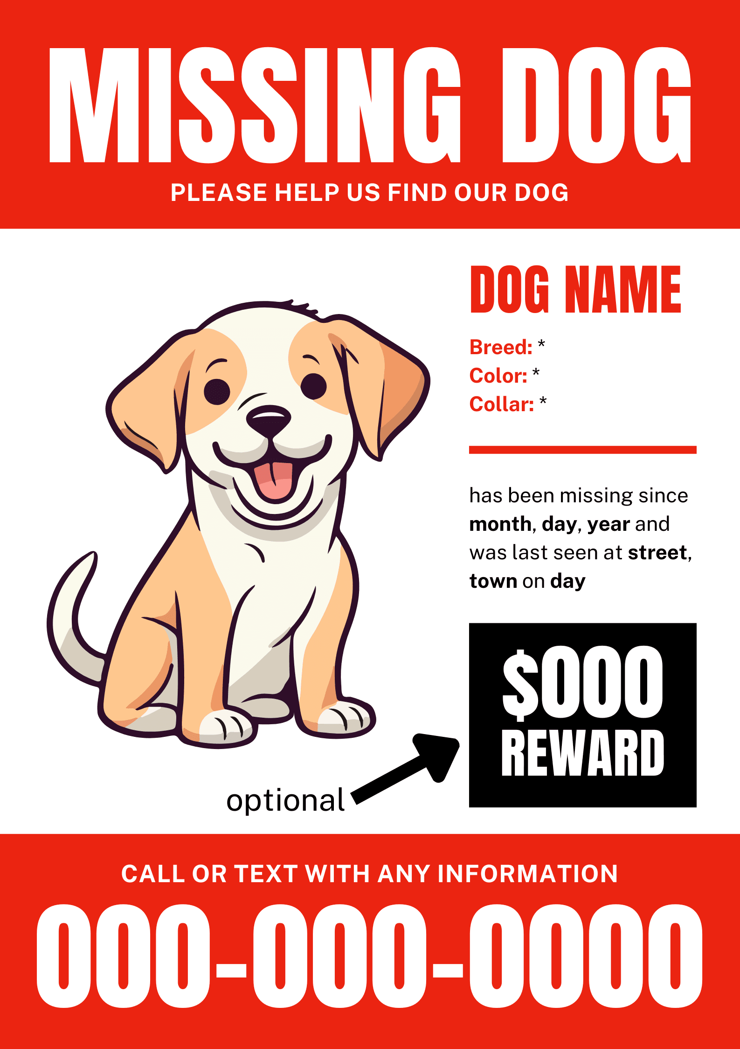
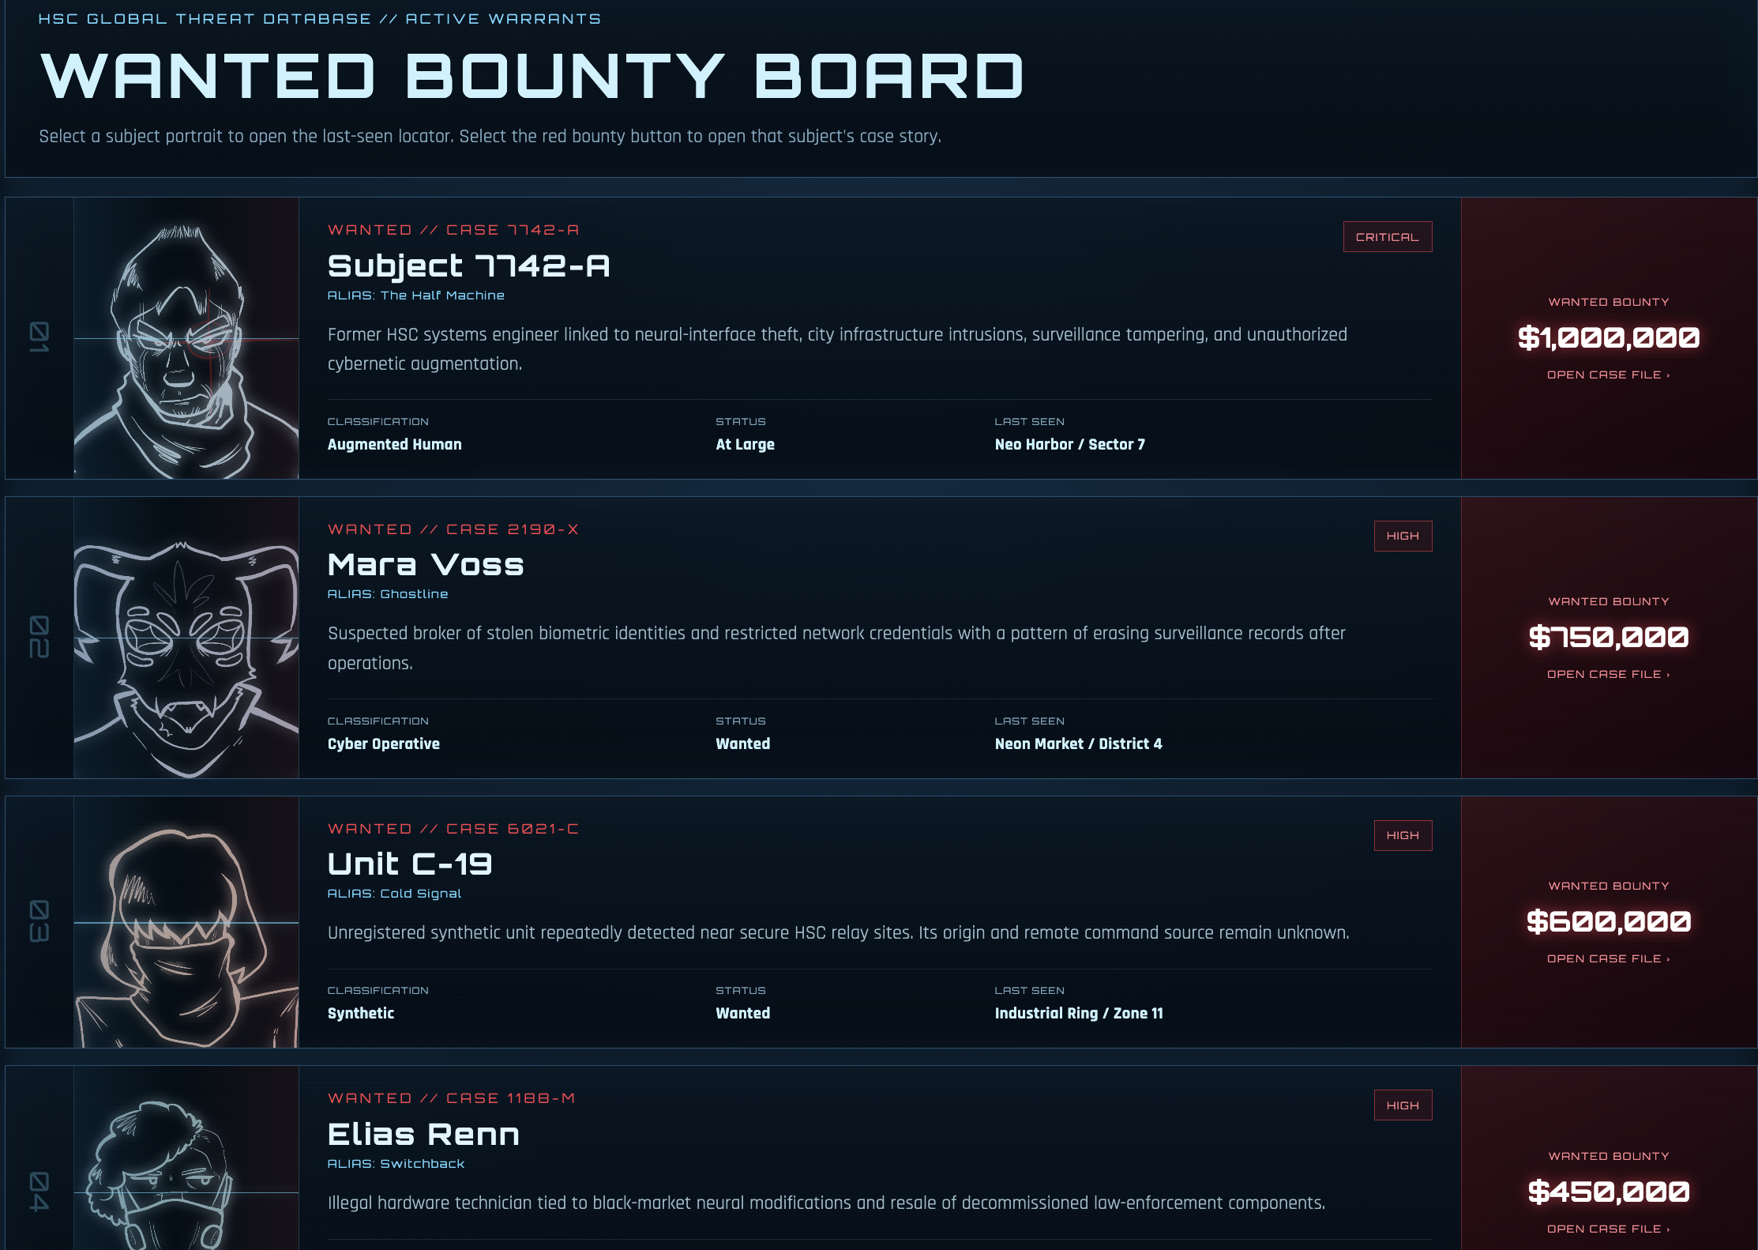
Wanted Bounty’s for missing dogs
View
ORG Mission
Beginning
Problem
Ending

Slide 2
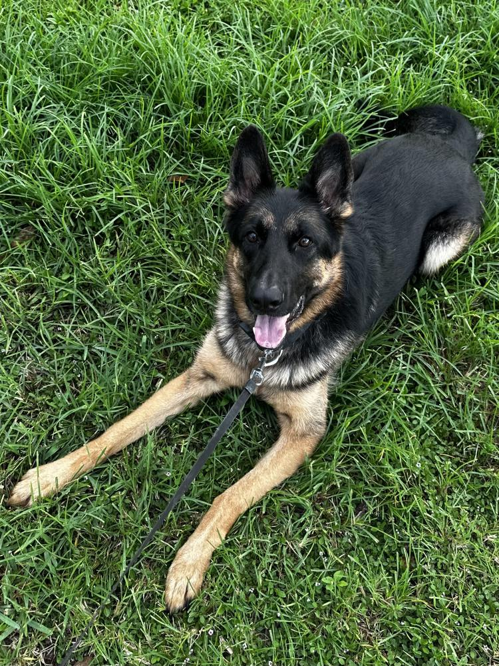
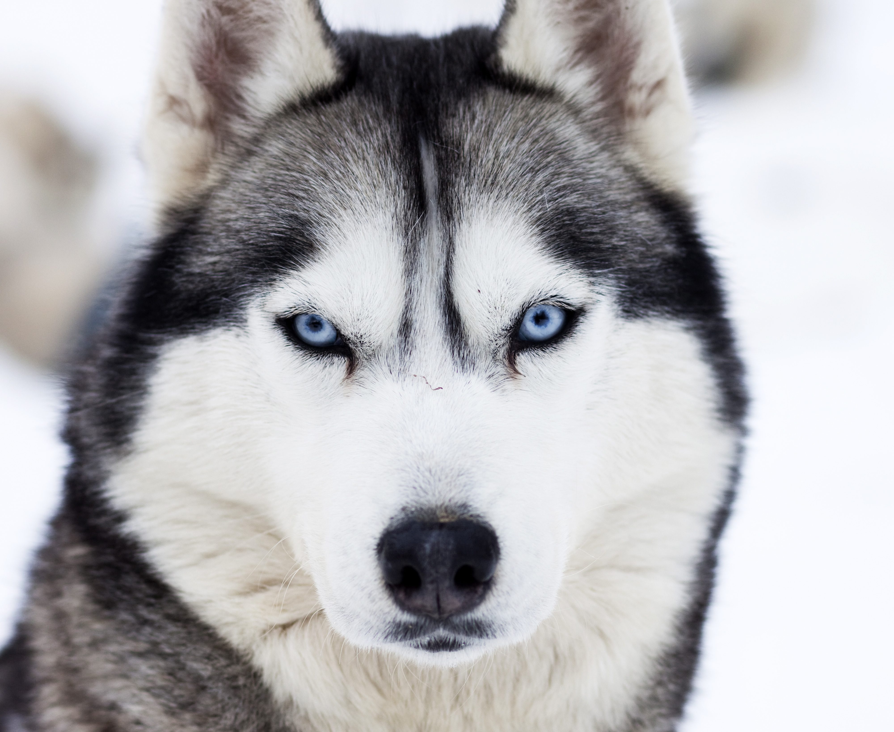
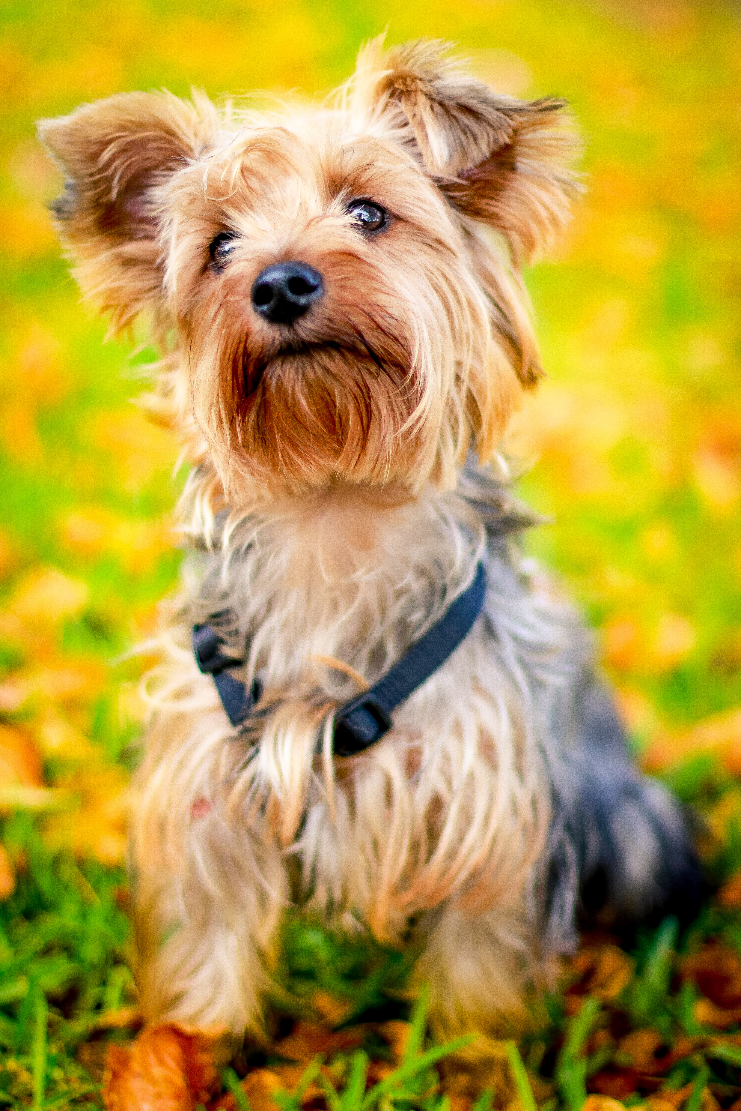
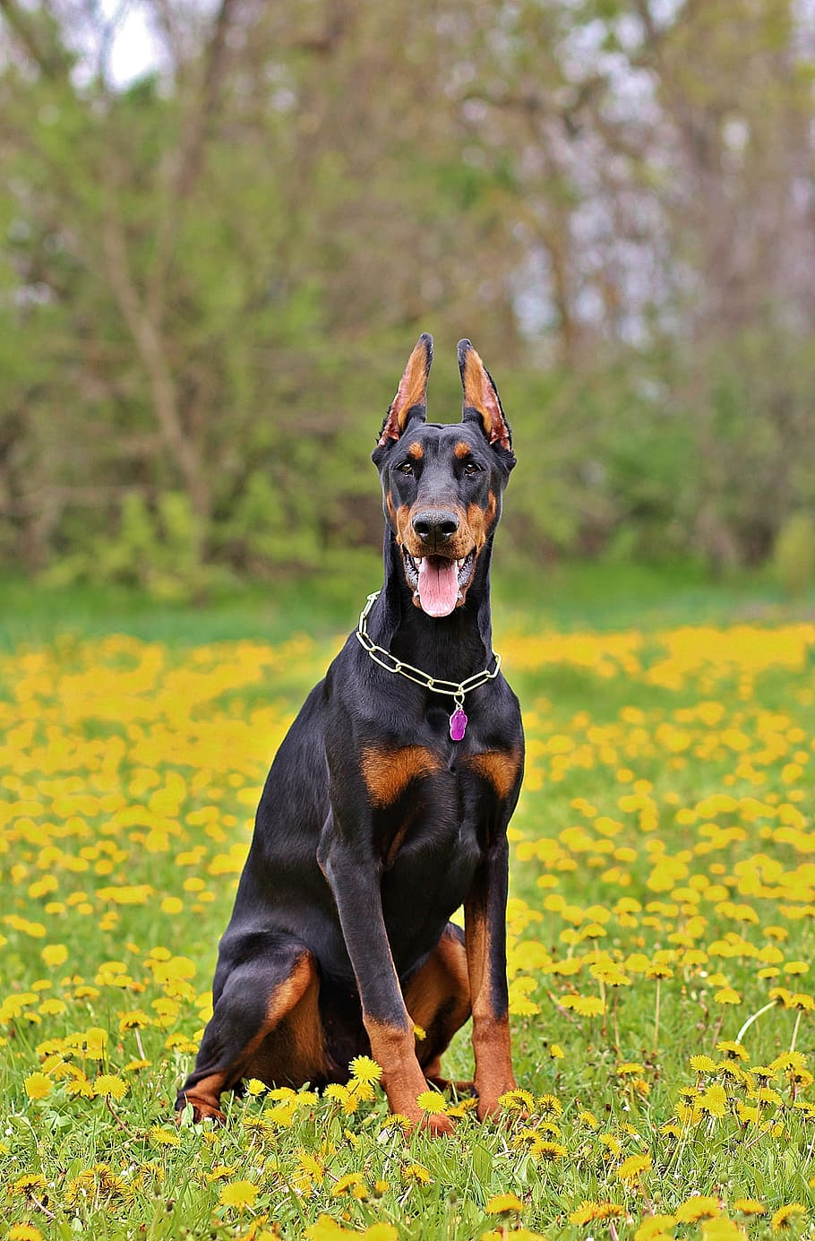
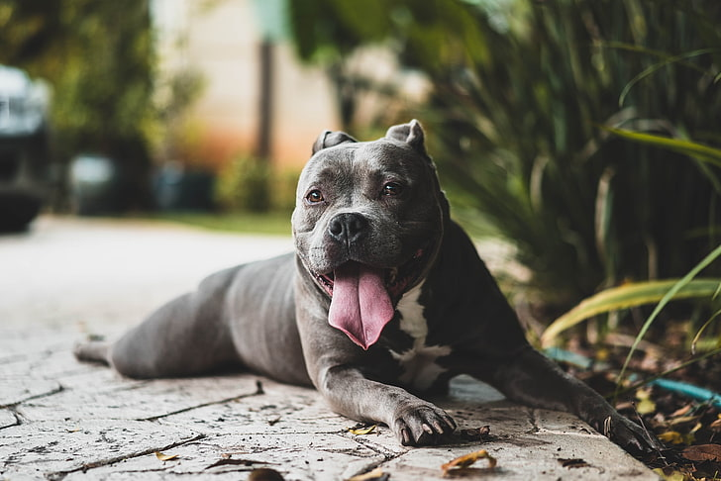
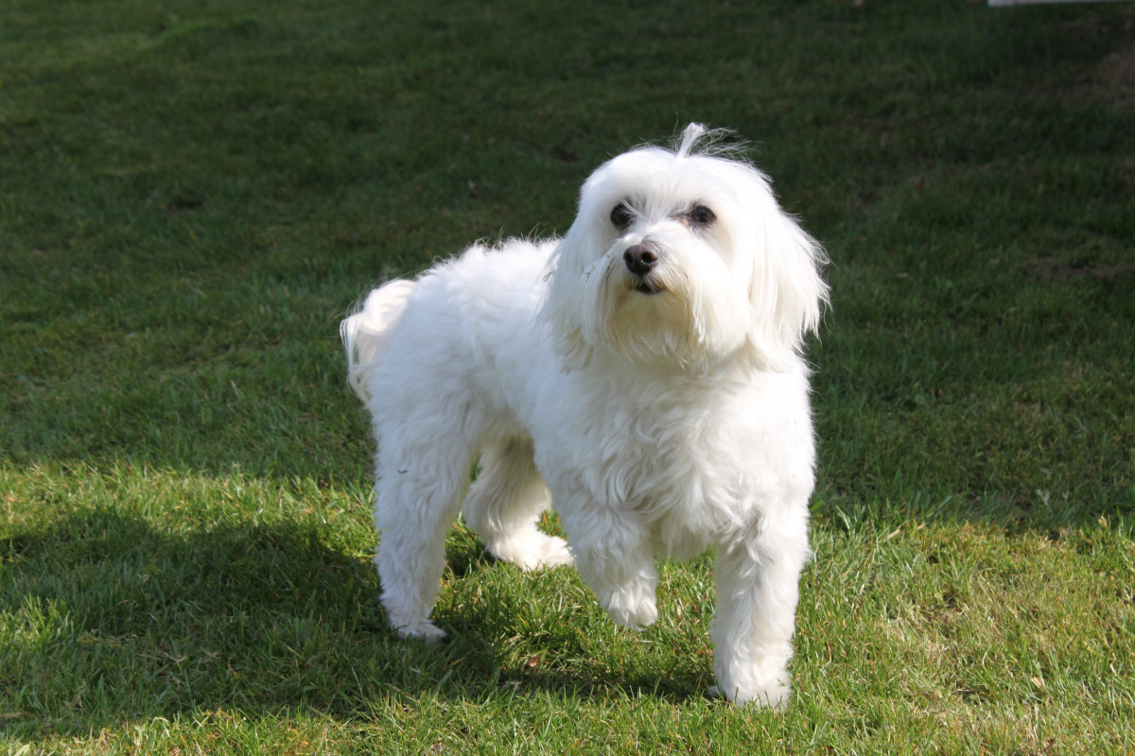
List of Bounty’s wanted for stealing dogs
Duke Husky 2 years old
Reward $3,500
Max Yorkie 3 years
Old Reward $2,500
Charlie German Shepard
4 years old Reward $3,000
Bob Rottweiler 2 years old
Reward $1000
Milo Doberman 3 years
Reward $3000
Mikey Maltese 1 years old
Reward $2000

Slide 3
Dog owners and HR contact information
Missing Dog owners contact information
Jose Gonzales for Bob Rotteweiler 777-890-9987
Charles Mendes for Mikey Maltese 654-321-7364
Raymond Sanchez for Max Yorkie 876-998-6732
Michael Chavez for Charlie German Shepard 623-443-7483
Steven Hernandez for Duke Husky 464-646-8346
Henry Dom for Milo Doberman 736-733-8732
HR contact information
Leah Aluni 555-663-8888
Monday-Friday 9:00AM-5:00PM
support@example.com

